Slide 1



Slide 2
DIABETES _PREDICATION TA S K 3 PREPARED BY - RAKH I GHULAXE
Welcome to the Diabetes Prediction Assessment presentation. In this guide, we will explore various data analysis and management techniques related to diabetes.

Slide 3

The diabetes_prediction file contains medical and demographic data of patients along with their diabetes status , whether positive or negative.
It consists of various features such as age ,gender , body mass index(BMI), hypertension, heart disease , smoking history,HbA1c level and blood glucose level.

Slide 4
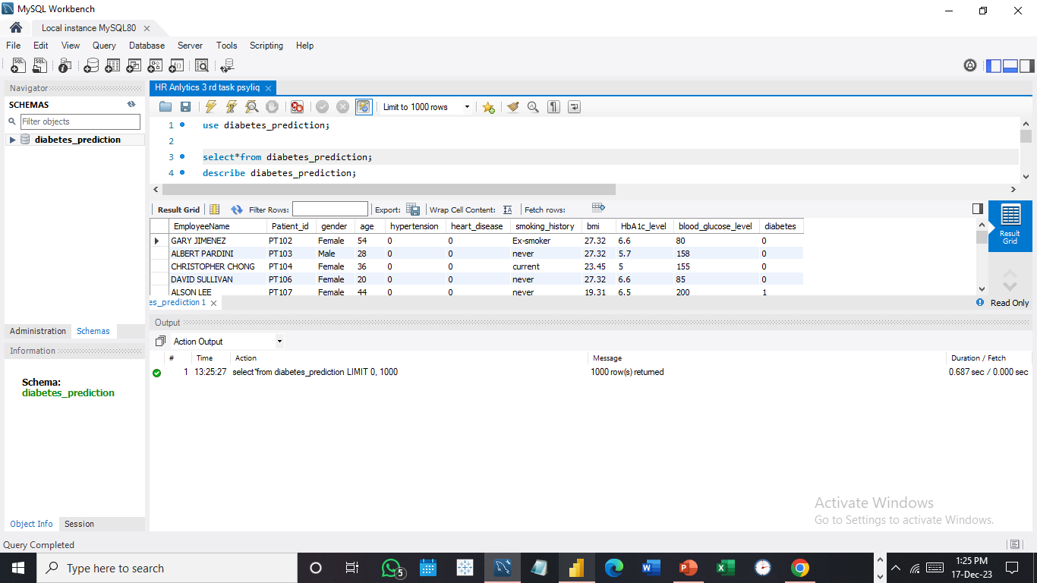
First view of dataset select * from diabetes_prediction;

Slide 5
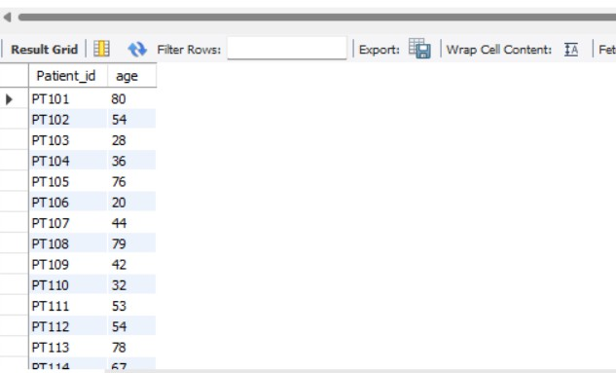
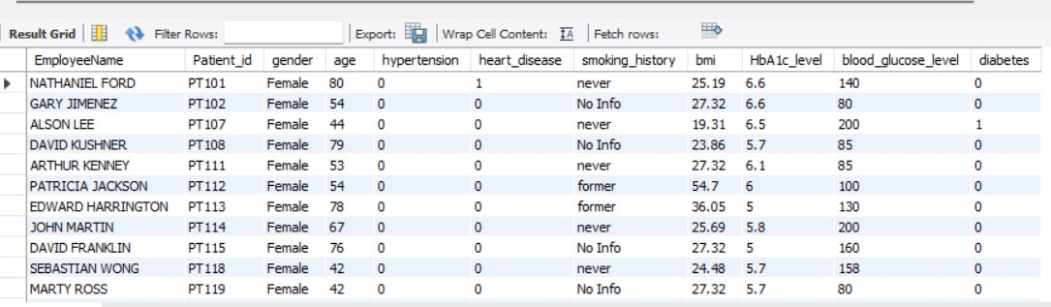
1. Retrieve the Patient_id and ages of all patients.
Ans: - Select Patient_id, age
from diabetes_prediction;
2. Select all female patients who are older than 40.
Ans: - Select * from diabetes_prediction
where gender = "Female" and age > 40;

Slide 6

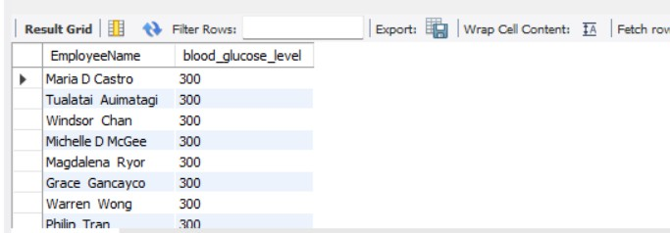
Ans: - Select avg(bmi) from diabetes_prediction;
3. Calculate the average BMI of patients.
4. List patients in descending order of blood glucose levels.
Ans: - Select * from diabetes_prediction
order by blood_glucose_level desc;

Slide 7
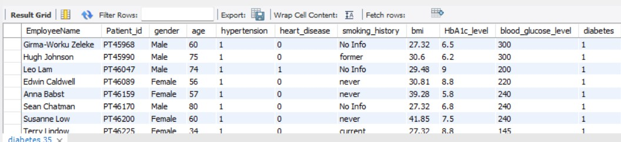

5. Find patients who have hypertension and diabetes.
Ans: - Select * from diabetes_prediction
where hypertension = 1 and diabetes = 1;
6. Determine the number of patients with heart disease.
Ans: - Select count(heart_disease)
from diabetes_prediction
where heart_disease = 1;

Slide 8
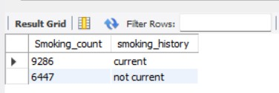
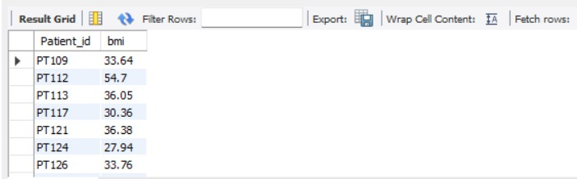
7. Group patients by smoking history and count how many smokers and nonsmokers there are.
Ans: - Select count(smoking_history) as Smoking_count, smoking_history
from diabetes_prediction
where smoking_history in ("not current","current")
group by smoking_history;
8. Retrieve the Patient_ids of patients who have a BMI greater than the average BMI.
Ans: - Select Patient_id, bmi
from diabetes_prediction
where bmi > (select avg(bmi) from diabetes_prediction);

Slide 9
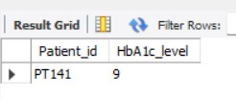
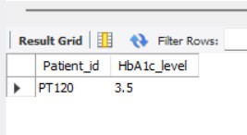
9. Find the patient with the highest HbA1c level and the patient with the lowest HbA1clevel.
Ans: - Select Patient_id, HbA1c_level
from diabetes_prediction
order by HbA1c_level desc limit 1;
Ans: - Select Patient_id, HbA1c_level
from diabetes_prediction
order by HbA1c_level asc limit 1;

Slide 10
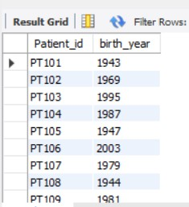
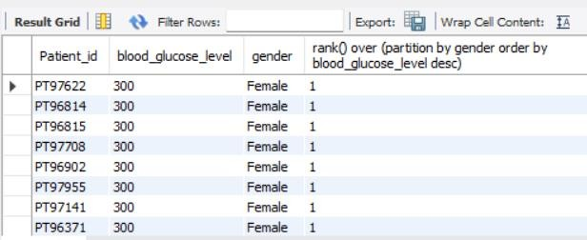
10. Calculate the age of patients in years (assuming the current date as of now).
Ans: - SELECT Patient_id, 2023 - age AS birth_year from diabetes_prediction;
11. Rank patients by blood glucose level within each gender group. Ans: - Select Patient_id, blood_glucose_level, gender,
rank () over (partition by gender order by blood_glucose_level desc)
from diabetes_prediction;

Slide 11
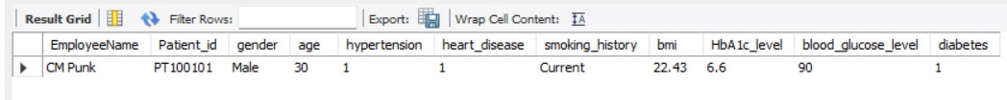
Update the smoking history of patients who are older than 50 to "Ex-smoker."
Ans: - Update diabetes_prediction
set smoking_history = "Ex-Smoker"
where age > 50 and Patient_id is not null;
Insert a new patient into the database with sample data.
Ans: - Insert into diabetes_prediction (EmployeeName, Patient_id, gender, age, hypertension, heart_disease, smoking_history, bmi, HbA1c_level, blood_glucose_level, diabetes)
values ("CM Punk", "PT100101", "Male", 30, 1, 1, "Current", 22.43, 6.6, 90, 1);
Select * from diabetes_prediction
where Patient_id = "PT100101";

Slide 12
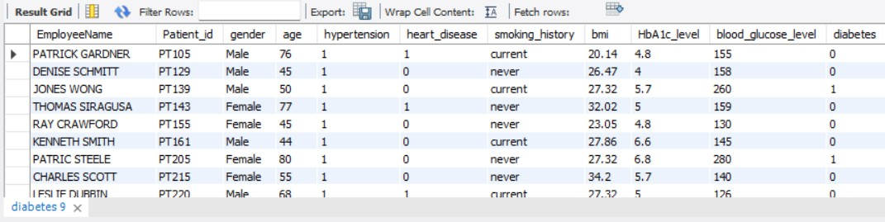
Delete all patients with heart disease from the database.
Ans: - Delete from diabetes_prediction
where heart_disease = 1;
Find patients who have hypertension but not diabetes using the EXCEPT operator. 2 of 2
Ans: - Select * from diabetes_prediction
where hypertension = 1 and Patient_id not in (Select 1 from diabetes_prediction where heart_disease =1);

Slide 13
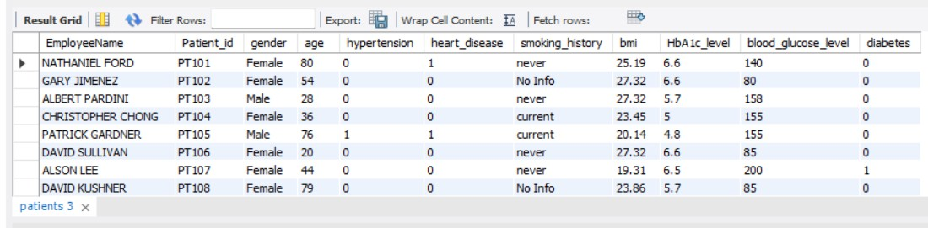
Define a unique constraint on the "Patient_id" column to ensure its values are unique.
Ans: - Alter table diabetes_prediction
add constraint patient_id unique (Patient_id);
Create a view that displays the Patient_ids, ages, and BMI of patients.
Ans: - Create View Patient as
Select Patient_id, age, bmi from diabetes_prediction; Select * from patient;

Slide 14
Suggest improvements in the database schema to reduce data redundancy and improve data integrity.
Reducing data redundancy and improving data integrity are important goals in designing a robust database schema. Here are some suggestions for improvements:
Normalization:
Break down large tables into smaller ones to avoid repeating groups of data.
Eliminate partial and transitive dependencies.
Use of Primary Keys:
Make sure each table has a primary key that uniquely identifies each record.
Consider using surrogate keys (e.g., auto-incrementing integers) if natural keys are complex or subject to change.
Foreign Keys:
Establish relationships between tables using foreign keys to maintain referential integrity.
4. Indexes:
- Use indexes wisely to improve query performance. Index columns that are frequently used in WHERE clauses or JOIN conditions.

Slide 15
5. Data Types:
- Use appropriate data types for each column to optimize storage and improve data integrity.
Default Values and Constraints:
Set default values for columns where applicable.
Use constraints to ensure that data adheres to business rules.
Avoid NULLs Where Possible:
Minimize the use of NULLs, especially in columns that participate in relationships or indexes.
Consider using default values instead of NULLs.
Data Validation:
Implement data validation at the database level using constraints and triggers.
Ensure that only valid data is stored in the database.
9. Regular Maintenance:
- Schedule regular database maintenance tasks, such as index rebuilding and statistics updates, to keep the database optimized.

Slide 16
19. Explain how you can optimize the performance of SQL queries on this dataset.
To optimize the performance of SQL queries on a dataset, there are several strategies that can be employed:
Indexing: Proper indexing can significantly improve query performance. Identify columns frequently used in
search conditions or join operations and create indexes on those columns.
Query Tuning: Analyze the structure and execution of queries to identify opportunities for optimization. This may involve restructuring queries, using appropriate join types, and avoiding unnecessary subqueries.
Normalization and Denormalization: Normalizing the database can reduce data redundancy and improve data
integrity, while denormalizing can optimize query performance by reducing the need for joins in certain cases.
Efficient Data Types: Use the most appropriate data types for columns to ensure efficient storage and faster query execution.
Use Analytical Functions: Leverage SQL analytical functions for tasks such as ranking, aggregation, and windowing, which can often be more efficient than traditional SQL logic.
Partitioning: If dealing with large datasets, consider partitioning tables to distribute data and queries across
multiple storage objects for improved performance.
Understanding Query Execution Plans: Use tools to analyze query execution plans to understand how the database engine processes queries and identify potential bottlenecks for optimization.
Regular Maintenance: Regularly update statistics, reorganize and rebuild indexes, and perform database
maintenance tasks to ensure optimal query performance.

